Slide 1
ARM MTE Study
3/29 Meeting

Slide 2
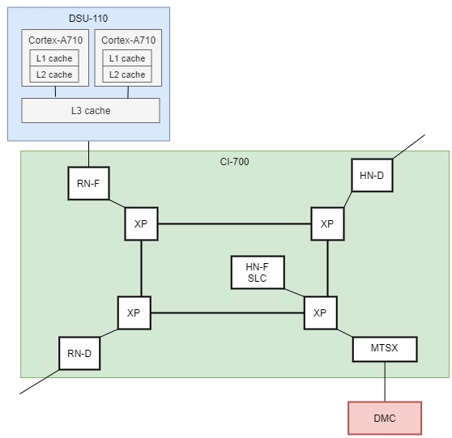
Bad news…
Arm does state where tags are stored
“The 4-bit memory tag associated with the aligned 16-byte region can be stored in the system memory, and can be cached in CPU processor cache and system cache”
MTE memory tags are stored in the Cortex-A710 L1 data cache, L2 cache, DSU L3 cache and CI-700 HN-F system level cache (SLC). For example, in L1 data cache, the 4-bit MTE tag is stored in the cache line tag ram.
Theoretically, 1,048,576 tags in its L3 cache (assuming a 16 MiB maximum size),
and/or 1,073,741,824 tags in its RAM (assuming a 16 GB size).
So in summary, tag checking is done upon each Ld/Str and tags are stored in CPU Cache

Slide 3
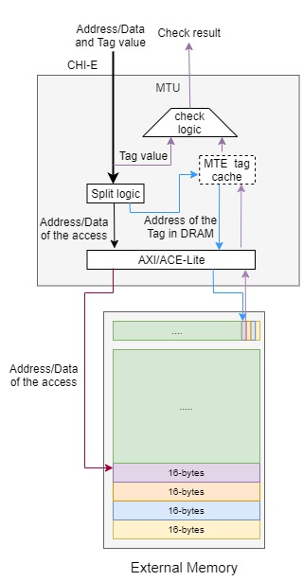
MTE Tag check logic
Unsure if we can somehow use AXI/ACE-Lite to our benefit

Slide 4
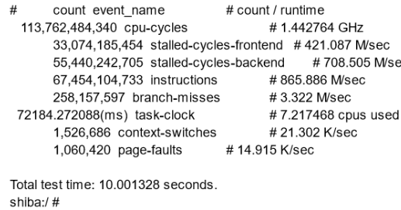
Benchmarking updates
Test 1 -> Invalid vs. Valid Tag Access time
~ 10x (20 with signal handling) overhead when a
tag fails for some reason
Test 2 -> continuous allocation of small arrays
Performance counter statistics are to the right
Malloc eventually begins to return a null pointer, and we eventually get a “2024-03-27 20:00:52.496 15238-16115 scudo com.example.mtestudy_benchmarking I Scudo ERROR: internal map failure”

Slide 5
(one) bypass technique tried:
allocates memory with MTE enabled and then attempt accesses to this memory across multiple threads, each tagged differently. Each thread accesses past the buffer size to see how MTE responds to such attempts.
Error 1 reached: SIGILL, code ILL_ILLOPN. According to a github repo, this means PAC caught the error
Fix, sighandle it and continue
Possibly an error mte misses somehow?
Error 2 reached: segfaults, lots of them….
Intentional, no bypass/unauthorized access succeeded unfortunately.
Error 3 reached: stack corruption detected (-fstack-protector) followed by Fatal signal 7 (SIGBUS), code 1 (BUS_ADRALN), fault addr 0x4002 in tid 3037 (dy_benchmarking), pid 2988 (dy_benchmarking)
Compiler-level protection, again not MTE protection (even though we’re buffer overflowing)
When running with MTE disabled, the error is not caught, it seems to run completely without any problem, so I’m unsure if perhaps this is due to MTE (which doesn’t help us :), so it’s most likely the code running incorrectly

Slide 6
Time Permitting
Swap changes don’t do anything
Can an attacker lower the volume of brute forcing the tag?
Manipulating the reporting of MTE errors
Especially async with a potential timing SCA

